Slide 1
Introduction to Recoverability

Slide 2
Introduction to Recoverability
In recoverability we address the effect of transaction failures during concurrent execution. If a transaction Ti fails, for whatever reason, we need to undo the effect of this transaction to ensure the atomicity property of the transaction. In a system that allows concurrent execution, it is necessary to ensure that any transaction Tj that is dependent on Ti is also aborted. To achieve this, we need to place restrictions on the type of schedules permitted in the system.
Types:
Recoverable
Irrecoverable

Slide 3
Recovery from Transaction Failures
A recovery is an integral part of a database system, which is responsible for detection of failures and recovery database. There are various techniques of recovery.
1. Cascadeless Schedules
2. Log Based recovery
3. Checkpoints

Slide 4
1. Cascadeless Schedules
If in a schedule, a transaction is not allowed to read a data item until the last transaction that has written it is committed or aborted, then such a schedule is called as a Cascadeless Schedule. In other words, Cascadeless schedule allows only committed read operations.

Slide 5
2. Log-Based Recovery
Log-based recovery in DBMS provides the ability to maintain or recover data in case of system failure. DBMS keeps a record of every transaction on some stable storage device to provide easy access to data when the system fails. A log file will be created for every operation performed on the database at that point. The original transaction should be processed before it is applied to the database.
The most widely used technique for Database recovery is log based recovery.

Slide 6
Logs
The Log which is usually written to stable storage, contains the redundant data required to recover from volatile storage failures and also from errors discovered by the transaction or the database system.

Slide 7
A log is a series of records. The logs for each transaction are kept in a log file to allow recovery in case of failure. A log is kept for each operation performed on the database. It is important to store the log before the actual transactions are applied to the database. Take the example of modifying a student's City. This transaction produces the following logs.
A start log is produced when the transaction begins. <Tn, Start>
A new log is written to the file when the City is changed from Chennai to NCR <Tn, City, 'Chennai', 'NCR' >
Once the transaction has been completed, another log will be written to indicate that the operation has been completed

Slide 8
How to Perform Log-Based Recovery in DBMS?
Command | Description
<Ti start> | The transaction Ti has begun.
<Ti, Xi, V1, V2> | The transaction Ti performed a write operation on item Xi, and Xi contains value v1 before the write and will contain value V2 after it was completed.
<Ti commit> | It commits a transaction.
<Ti abort> | It aborts a transaction.
Name | Description
Transaction identifier | It is an identifier that distinguishes one transaction from another.
Data item identifier | It uniquely identifies data.
Old value | This is the value of the data item before writing.
New value | This is the value of an item after it has been written.

Slide 9
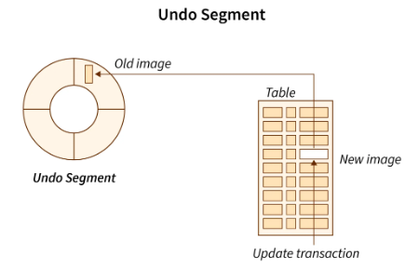
Transactions that perform a write operation to the database only modify it when a log record is created for that write operation. The logs may or may not record the reading of data items. The reason is that reading a data item has no effect on the consistency of the database and is not beneficial to the recovery mechanism.
During the recovery process, we perform two operations:
1. Undo(Ti): Restores the old values of each of the items in Ti that have been updated by the transaction Ti.

Slide 10
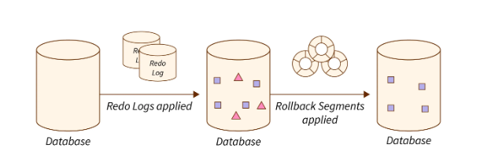
Redo(Ti): Updates all data items updated by transaction Ti with their new values. Undoing a T requires the log to contain both the record <start> and the record <commit>.

Slide 11
Deferred update
The idea behind deferred update is to defer or postpone any actual updates to the database itself until the transaction completes its execution successfully and reaches its commit point. During transaction execution, the updates are recorded only in the log and in the transaction workspace. After the transaction reaches its commit point and the log is force-written to disk, the updates are recorded in the database itself. If a transaction fails before reaching its commit point, there is no need to undo any operations, because the transaction has not affected the database in any way.
The steps involved in the deferred update protocol are as follows:
When a transaction starts, write an entry start_transaction(T) to the log.
When any operation is performed that will change values in the database, write a log entry write_item(T, x, old_value, new_value).
When a transaction is about to commit, write a log record of the form commit(T); write all log records to disk.
Commit the transaction, using the log to write the updates to the database; the writing of data to disk need not occur immediately.
If the transaction aborts, ignore the log records and do not write the changes to disk.

Slide 12
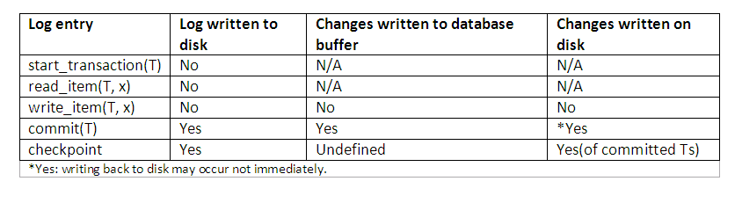
The database is never updated until after the transaction commits, and there is never a need to UNDO any operations. Hence this technique is known as the NO-UNDO/REDO algorithm. The REDO is needed in case the system fails after the transaction commits but before all its changes are recorded in the database. In this case, the transaction operations are redone from the log entries. The protocol and how different entries are affected can be best summarised as shown:

Slide 13
Deferred Database Modification
All database modifications are recorded in the log using the delayed database modification technique to ensure transaction atomicity. As a part of this technique, a transaction is only partially committed when all the written statements are applied to the database. As soon as the final action of an order has been completed, the order is said to be partially committed.
Whenever a partial commit occurs, deferred writes are executed according to the information in the transaction log. The information on the log is ignored if the system crashes before a transaction has been completed or if the transaction aborts. With the log, the system can deal with events that result in a loss of information on volatile storage. The recovery procedure uses the log.

Slide 14
Deferred Database Modification
It resets the values of data items that were updated by transaction Ti. The log includes a list of the data items that Ti updated and their new values. Redo transactions must be reversible. Repeating them many times must have the same effect as performing them once.
In the event of a failure, the recovery subsystem consults the log for information about which transactions need to be redone. If the log record includes both <Ti start> and <Ti commit> statements, Transaction Ti is redone.

Slide 15
Deferred Database Modification
(A) (B)
<To start> <To start>
<To A, 1000> <To A , 1000>
<To B, 305> <To B, 3050>
<To commit>
<T1 start>
<T1 C, 500>
There is a failure just after the record for step write(B) of transaction To. The recovery process will not perform any redo operations as we only have <To start> in our log record, but not <To commit>.

Slide 16
Deferred Database Modification
When a system crash occurs just after writing the log record C, during recovery we do only redo (To), since the log disk only contains data to commit and to start. However, we don't have the <T1 commit> in log disk at the same time, so we can't do the redo (T1).
(C)
<To start>
<To A, 1000>
<To B, 3050>
<To commit>
<T1 start>
<T1 C, 500>
<T1 commit>
If the system crashes just after the log record <T1 commit>, then during the recovery we will do both redos (T0) and redos (TI) since we have both <To start> and <To commit> and <T1 start>, <T1 commit> in log disk..

Slide 17

Example Deferred Database Modification
Consider the following transaction TRAN1
Using deferred update, the process is:
Transaction TRAN1
read(A)
write(10,B)
write(20,C)
Commit
Time | Action | Log
t1 | START | -
t2 | read(A) | -
t3 | write(10,B) | B = 10
t4 | write(20,C) | C = 20
t5 | COMMIT | COMMIT

Slide 18
Example Deferred Database Modification
If the DMBS fails and is restarted:
The disks are physically or logically damaged then recovery from the log is impossible and instead a restore from a dump is needed.
If the disks are OK then the database consistency must be maintained. Writes to the disk which was in progress at the time of the failure may have only been partially done.
Parse the log file, and where a transaction has been ended with `COMMIT' apply the data part of the log to the database.
If a log entry for a transaction ends with anything other than COMMIT, do nothing for that transaction.
flush the data to the disk, and then truncate the log to zero.
the process or reapplying transaction from the log is sometimes referred to as `rollforward'.

Slide 19
Immediate Database Modification
Immediate update, or UNDO/REDO, is another algorithm to support ABORT and machine failure scenarios.
While a transaction runs, changes made by that transaction can be written to the database at any time. However, the original and the new data being written must both be stored in the log BEFORE storing it on the database disk.
On a commit:
All the updates which has not yet been recorded on the disk is first stored in the log file and then flushed to disk.
The new data is then recorded in the database itself.
On an abort, REDO all the changes which that transaction has made to the database disk using the log entries.
On a system restart after a failure, REDO committed changes from log.

Slide 20
Immediate update
In the immediate update techniques, the database may be updated by the operations of a transaction immediately, before the transaction reaches its commit point. However, these operations are typically recorded in the log on disk by force-writing before they are applied to the database, so that recovery is possible.
When immediate update is allowed, provisions must be made for undoing the effect of update operations on the database, because a transaction can fail after it has applied some updates to the database itself. Hence recovery schemes based on immediate update must include the capability to roll back a transaction by undoing the effect of its write operations.
When a transaction starts, write an entry start_transaction(T) to the log;
When any operation is performed that will change values in the database, write a log entry write_item(T, x, old_value, new_value);
Write the log to disk;
Once the log record is written, write the update to the database buffers;
When convenient, write the database buffers to the disk;
When a transaction is about to commit, write a log record of the form commit(T);
Write the log to disk.

Slide 21
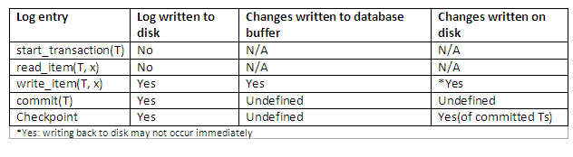
The protocol and how different entries are affected can be best summarised below:
In general, we can distinguish two main categories of immediate update algorithms. If the recovery technique ensures that all updates of a transaction are recorded in the database on disk before the transaction commits, there is never a need to redo any operations of committed transactions. Such an algorithm is called UNDO/NO-REDO. On the other hand, if the transaction is allowed to commit before all its changes are written to the database, we have the UNDO/REDO method, the most general recovery algorithm.

Slide 22
Approaches to Modify the Database
In the recovery system, we use two different types of medication in the database. They are
Immediate Database Modification
By using immediate updates, the database can be modified and output while still in the active state of the transaction. Data modifications written during an active transaction are referred to as uncommitted modifications.

Slide 23
Immediate Database Modification
For consistency reasons, old values of data items should be used if the system crashes or a transaction fails. Undoing an operation is a way to accomplish this. In order for Ti to start its execution, a log entry called <Ti start> is written. A new update record is written to the log before the write(X) operation by Ti is executed. Partially committed Ti records are written to the log as <Ti commit>.
<To start>
<To A, 850, 800>
<To B, 1000, 1050>
<To commit>
<T1 start>
<T1 C, 600, 500>
<Ti commit>

Slide 24
The following are examples of a banking system, the transaction To is followed by the transaction T1. In the case of a system crash right after the log record, and during recovery, we redo (T1) and undo (T1) since the log record includes both <To start> and <To commit>. However, the log record does not contain a <T1 commit> with a <T1 start>. First, we should undo (T1), and then we should redo (To).
<To start>
<To A, 850, 800>
<To B, 1000, 1050>
<To commit>
<T1 start>
<T1 C, 600, 500>
<Ti commit>

Slide 25

Example Immediate Database Modification
Using immediate update, and the transaction TRAN1 again, the process is:
Time | Action | LOG
t1 | START | -
t2 | read(A) | -
t3 | write(10,B) | Was B == 6, now 10
t4 | write(20,C) | Was C == 2, now 20
t5 | COMMIT | COMMIT

Slide 26
Example Immediate Database Modification
If the DMBS fails and is restarted:
The disks are physically or logically damaged then recovery from the log is impossible and instead a restore from a dump is needed.
If the disks are OK then the database consistency must be maintained. Writes to the disk which was in progress at the time of the failure may have only been partially done.
Parse the log file, and where a transaction has been ended with `COMMIT' apply the `new data' part of the log to the database.
If a log entry for a transaction ends with anything other than COMMIT, apply the `old data' part of the log to the database.
flush the data to the disk, and then truncate the log to zero.

Slide 27
Difference
Feature | Deferred Update | Immediate Update
Update timing | Updates occur after instruction execution | Updates occur during instruction execution
Processor speed | May be faster: update occurs after instruction execution, allowing for multiple updates to be performed at once | May be slower: update occurs during instruction execution, potentially causing the processor to stall
Complexity | More complex: requires additional instructions or mechanisms to handle updates after instruction execution | Less complex: updates occur immediately during instruction execution
Consistency | May result in temporary inconsistency between data in registers and memory | Data in registers and memory are always consistent
Flexibility | May be more flexible: allows for more complex data manipulations and algorithms | Less flexible: immediate updates can limit the range of data manipulations and algorithms that can be performed

Slide 28
Recovery using Log records
The system uses the log to determine what transactions need to be undone and which need to be re-done if the system crashes.
The log should contain the records <Ti, Start> and <Ti, Commit> or <Ti, Commit>; otherwise, the Transaction Ti should be redone. There should be an undo of Transaction Ti if the log contains the record <Tn, Start> but does not contain the record <Ti, commit> or <Ti, abort>.

Slide 29
Conclusion
In simple terms, a log is simply a file containing a sequence of records, each record representing a write operation. The log file is a stream of log records. It stores the history of all changes made to the logs.
Logs contain the start and end of transactions, transaction numbers, record numbers, old value, new value, etc. Examples include mini statements in bank ATMs.
A log is stored on a disk, so it is independent of disk failure and failures.

Slide 30
Thank You

